Slide 1

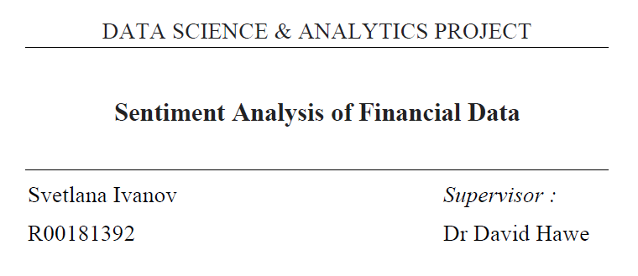

Slide 2



Slide 3

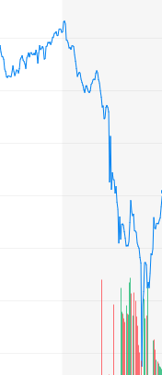


Sentiment analyser
Source of news
VADER
Social media
OIL

Slide 4

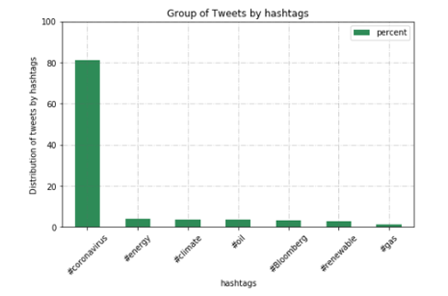
Tweeter API : OAuth 1.0a
Access to Streaming
Python: Tweepy
JSON format
FILTER: "#renewable", "#climate", "#gas", "#energy", “oil”, "#Bloomberg", "#COVID-19", “#coronavirus"
20/03/2020-05/05/2020
555 files
48 days
More than 9 mln tweets
near 67 Gb

Slide 5

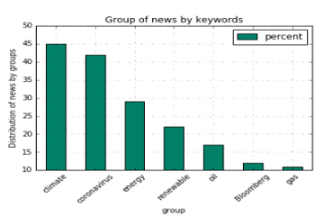
Keywords:
"renewable", "climate", "gas", “oil”, "energy", "Bloomberg", "COVID-19", “coronavirus"
Manual collection
Excel file
Near 500 articles
16/02/2010-05/05/2020
66 days

Slide 6
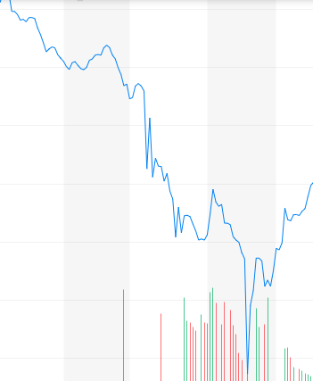
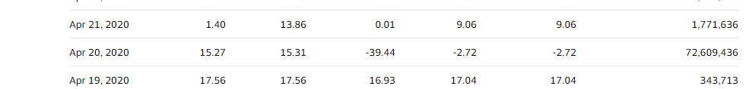
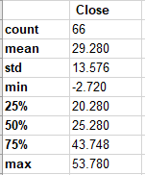
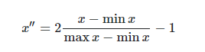
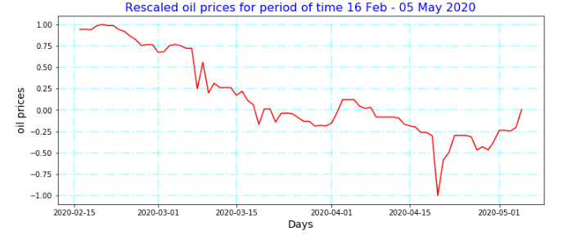
Price of oil
Rescale formula
Yahoo Finance
CSV file

Slide 7
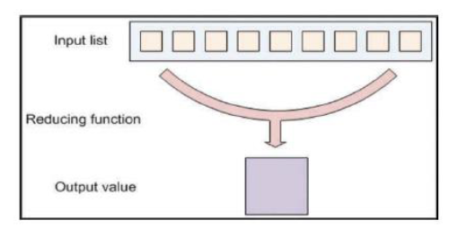
MapReduce approach
555 files
1 file 555 rows
48 aggregated rows

Slide 8
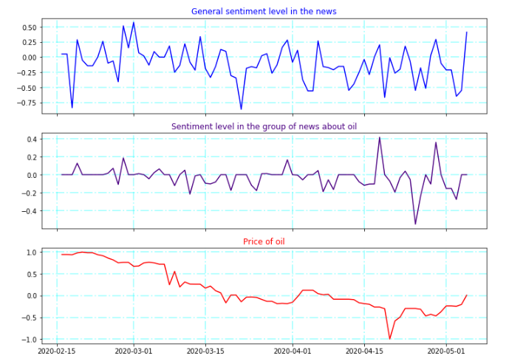
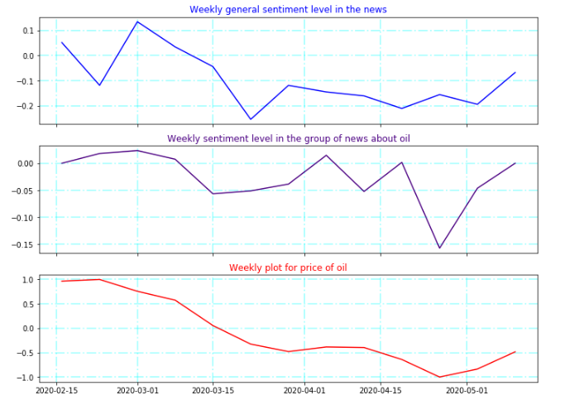
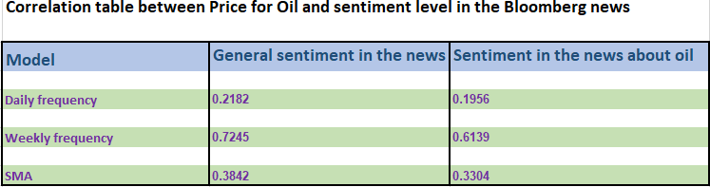
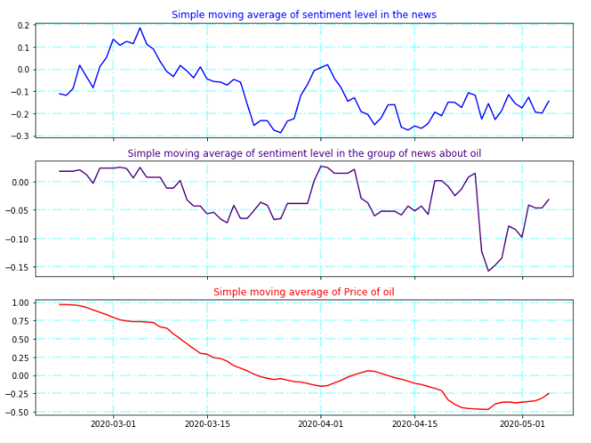
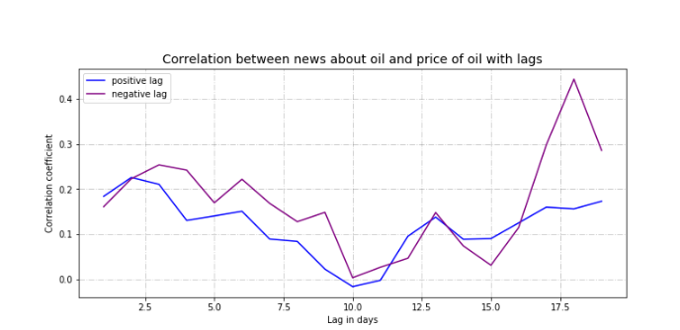
News vs price of oil

Slide 9
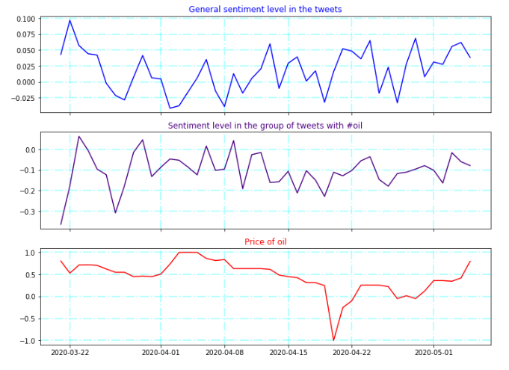
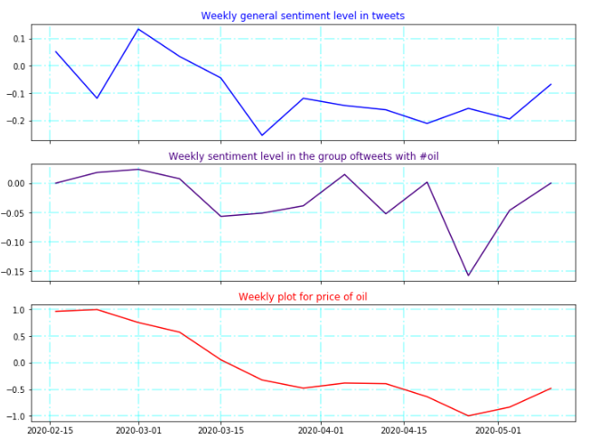
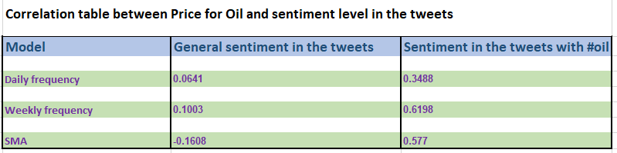
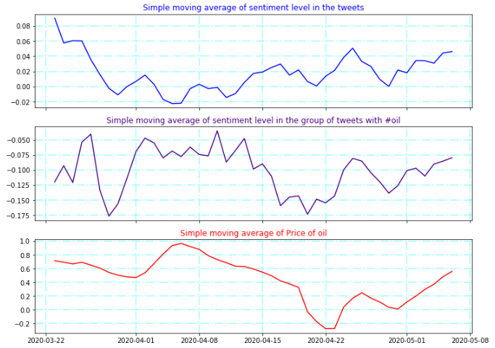
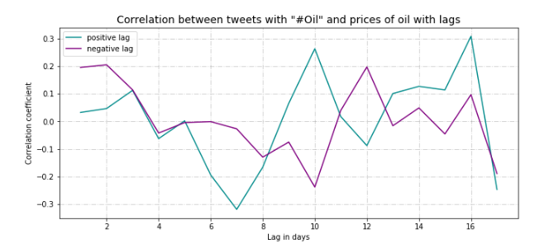
Tweets vs price of oil

Slide 10
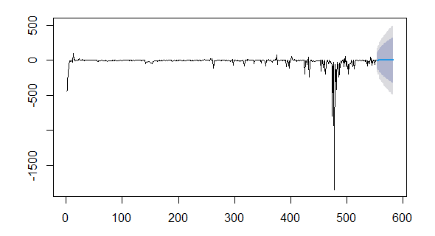
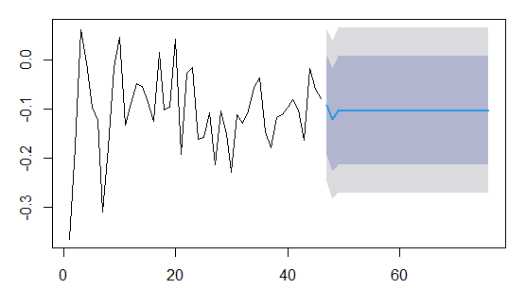
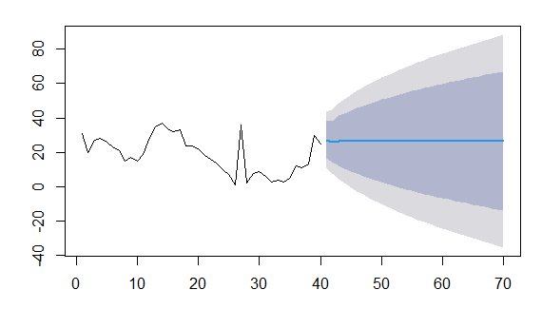
ARIMA models
News
Tweets
Price of oil

Slide 11


Recommendations
Longer period for data collection with access to an archive
Few news sources
Tweets only from related financial users
Additional factors for the formula

Slide 12


